Slide 1
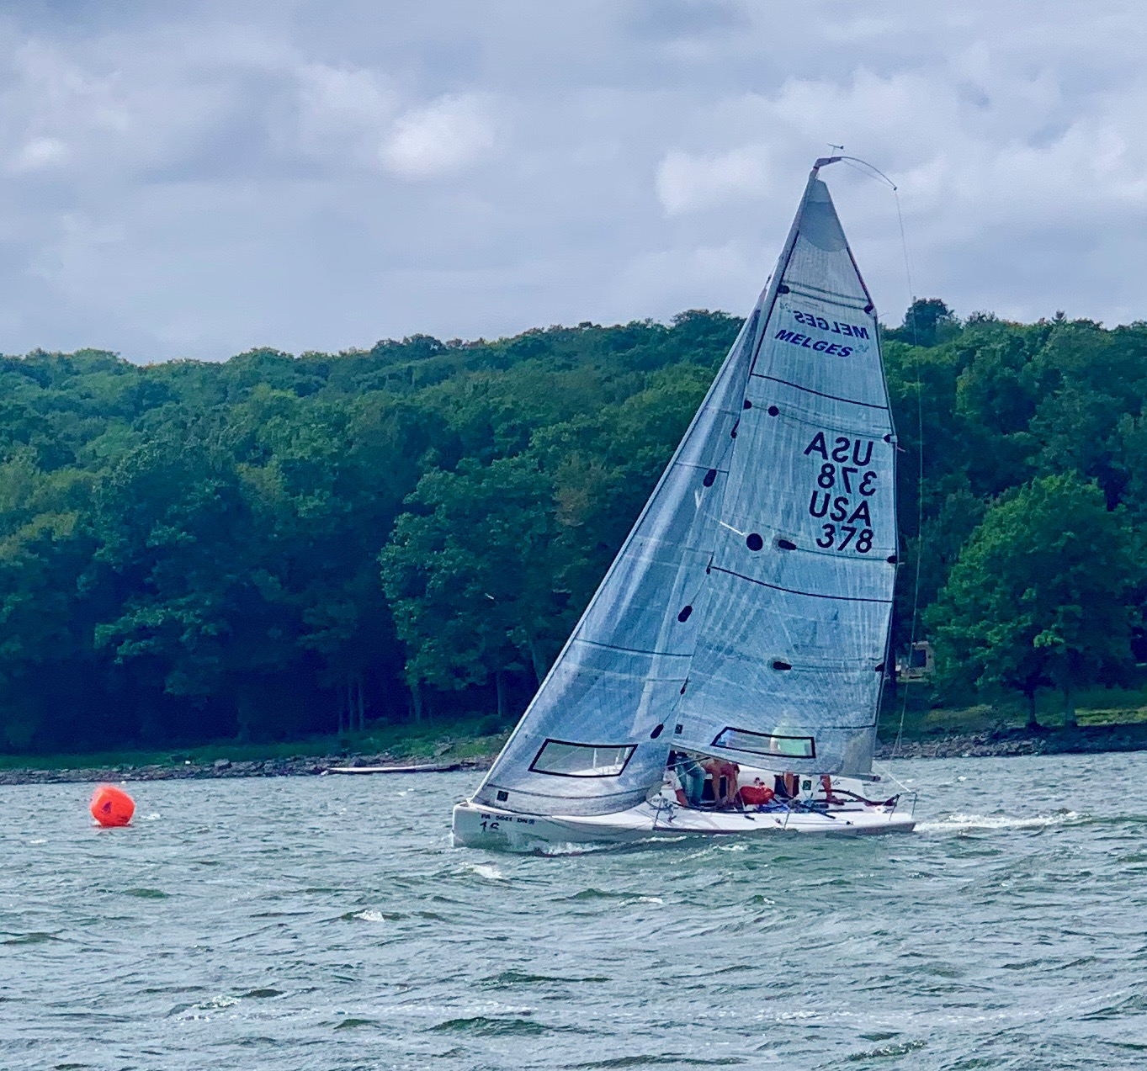
Paupack Sailing Club 2022 Educational Session
Call Kevin at 484-357-7831 if you need assistance
Or Chat in the Zoom Meeting

Slide 2
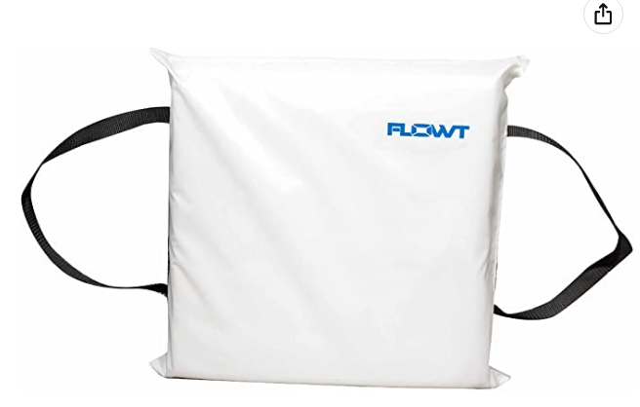
Paupack Sailing Club Safety
USCG Approved Wearable Life jacket
Use within label
Free of defects ie. No rips/buckles and straps in working order
Readily accessible – stowed within easy reach
Appropriate size
Throwable Floatation Device
Immediately available within arms reach
None can be in a container or factory packaging

Slide 3
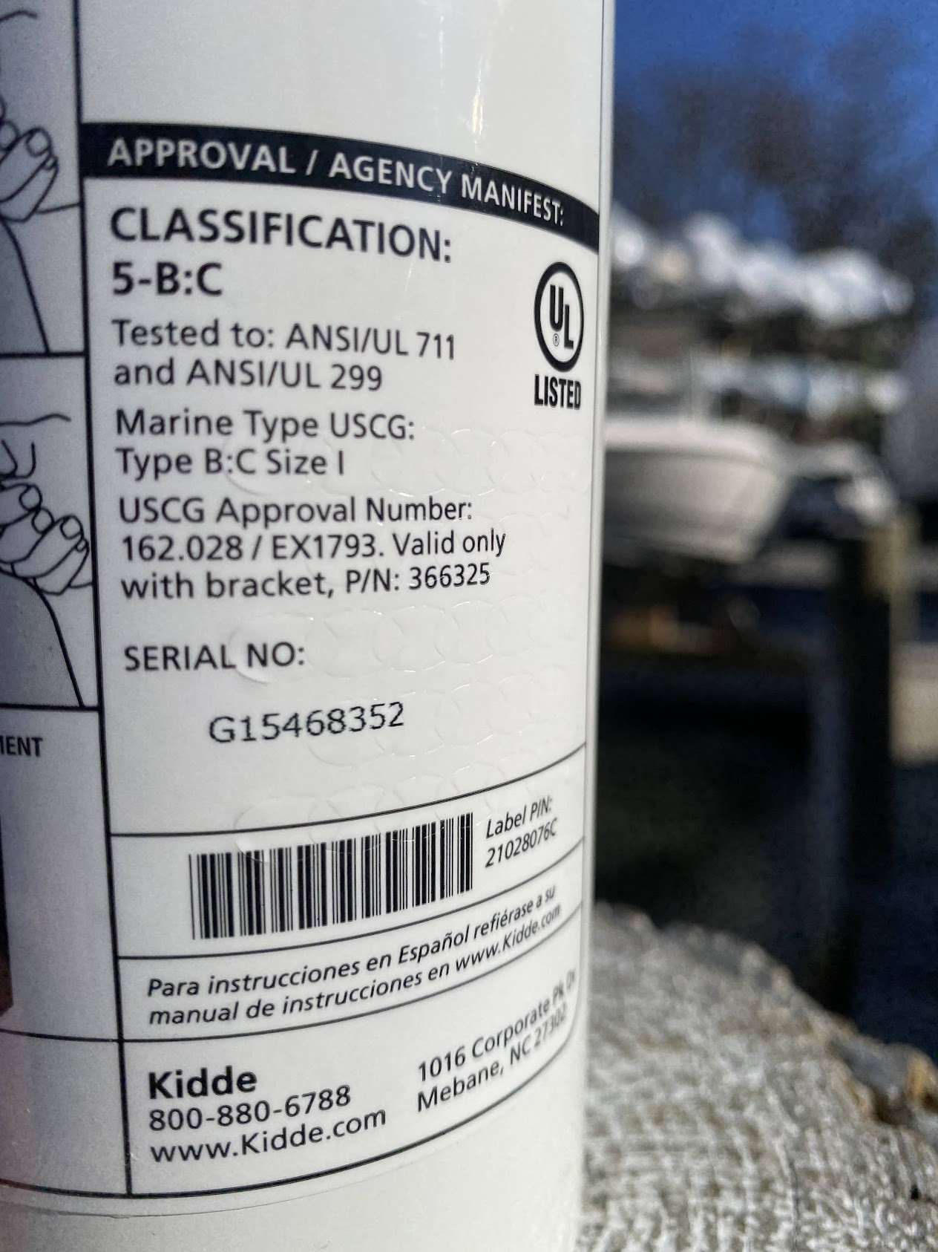
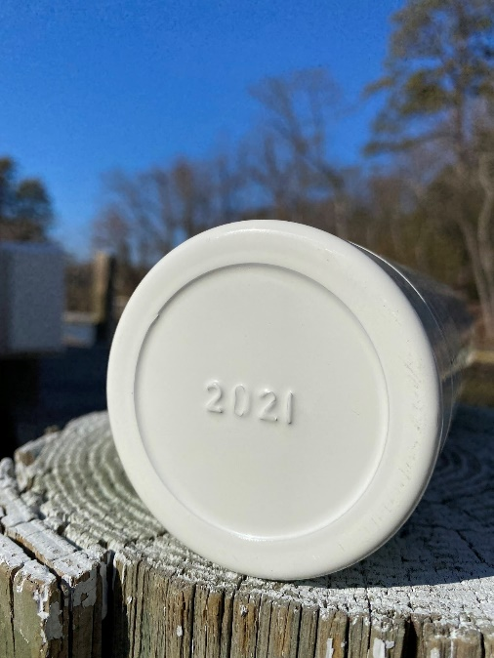
Paupack Sailing Club Safety
Fire Extinguisher
New Regulations As of April 20, 2022
Must State: Marine Type – USCG Approved
ABC – Solid, Liquid, Chemicals
Older than 2017, B-I or B-II required
ABC rating the best
Fire Extinguisher cannot be older than 12 years
05 on bottom means 2005 manufacturing date
26+ boats need 2 Fire Extinguishers
Mount vertically, readily accessible

Slide 4
Paupack Sailing Club Safety
USCG Safety Inspections
Life Vests and Fire Extinguishers
Backfire flame control – each carburetor of gasoline engines
Registration and Numbering
Navigation Lights if cruising after sunset
Ventilation
Distress Signals (flares, horns, etc.)
Battery Covers and Connections

Slide 5
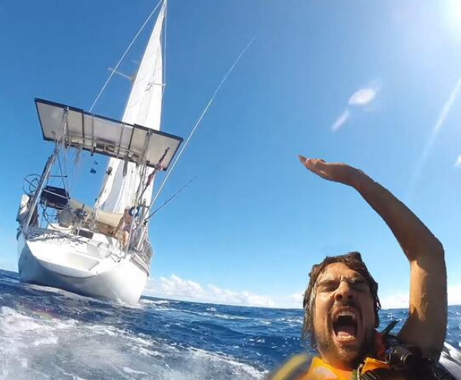
Paupack Sailing Club Safety - Man Overboard
Throw Life Ring
Mark Position
3 horn/whistle blasts
Note Wind Speed and Direction
Post Outlooks
Recovery
Practice Man Overboard
with a floatation device

Slide 6
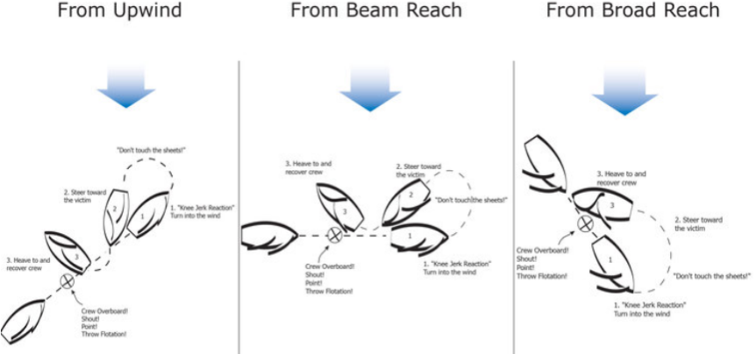
Paupack Sailing Club Safety - Man Overboard

Slide 7
Paupack Sailing Club Safety
Rendering Aid
In the United States, federal law (46 USCS sec. 2304) requires the master of any vessel subject to U.S. jurisdiction to “render assistance to any individual found at sea in danger of being lost,” so long as the assistance can be rendered without endangering the rescuing vessel or individuals on board.

Slide 8
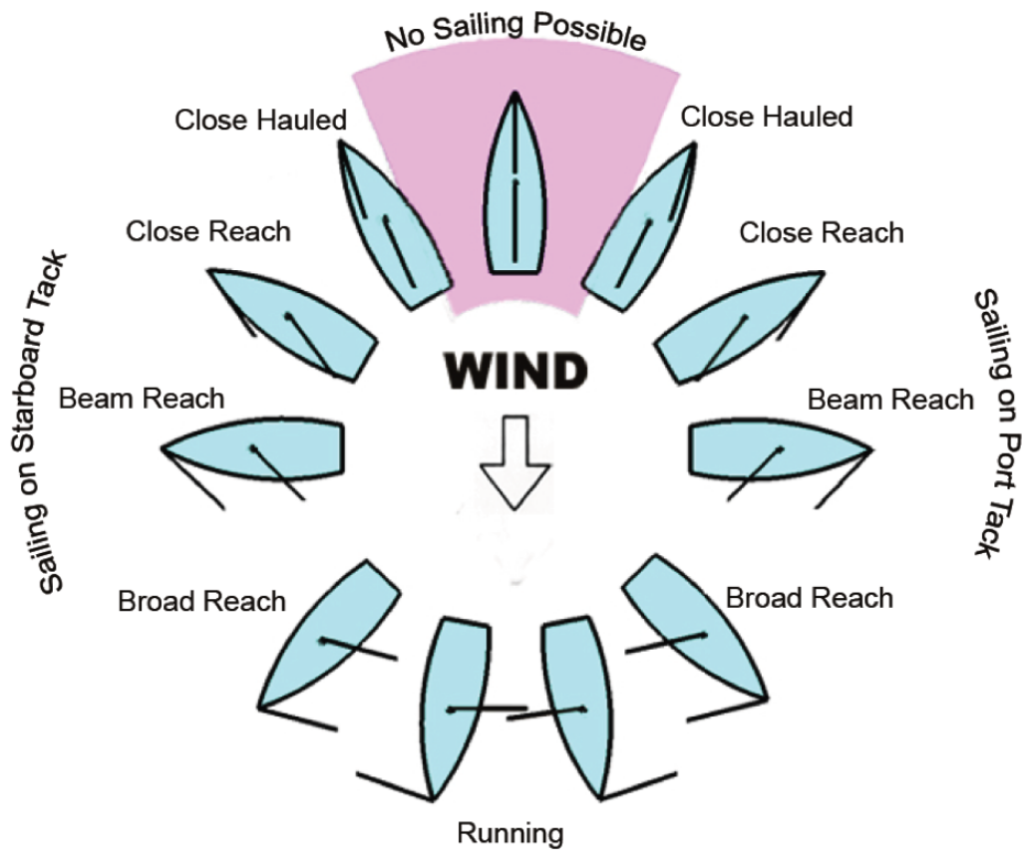
Paupack Sailing Club Right of Way - Points of Sail

Slide 9
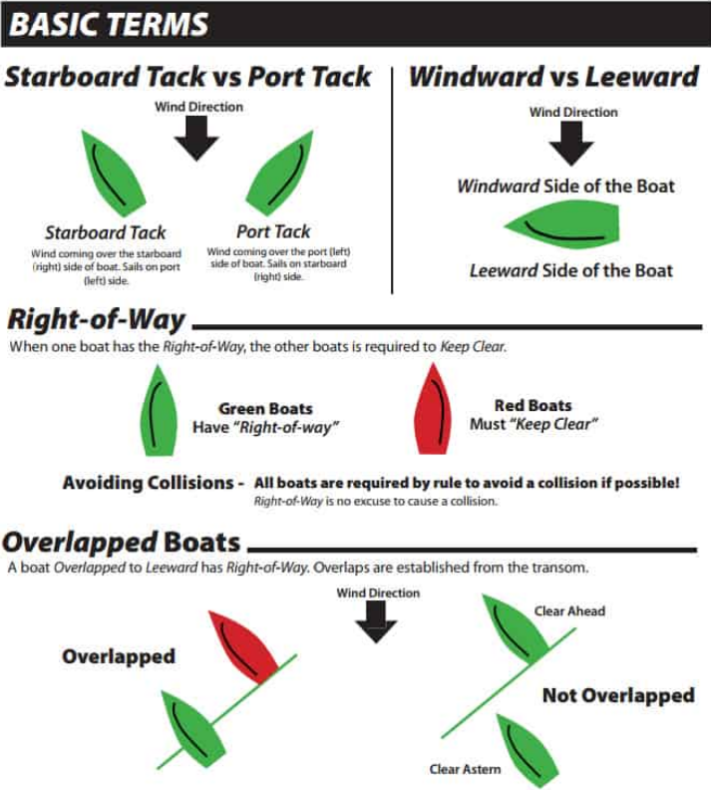
Paupack Sailing Club Right of Way
Terms used
Port
Starboard
Windward
Leeward
Overtaking
Stand On
Give Way

Slide 10
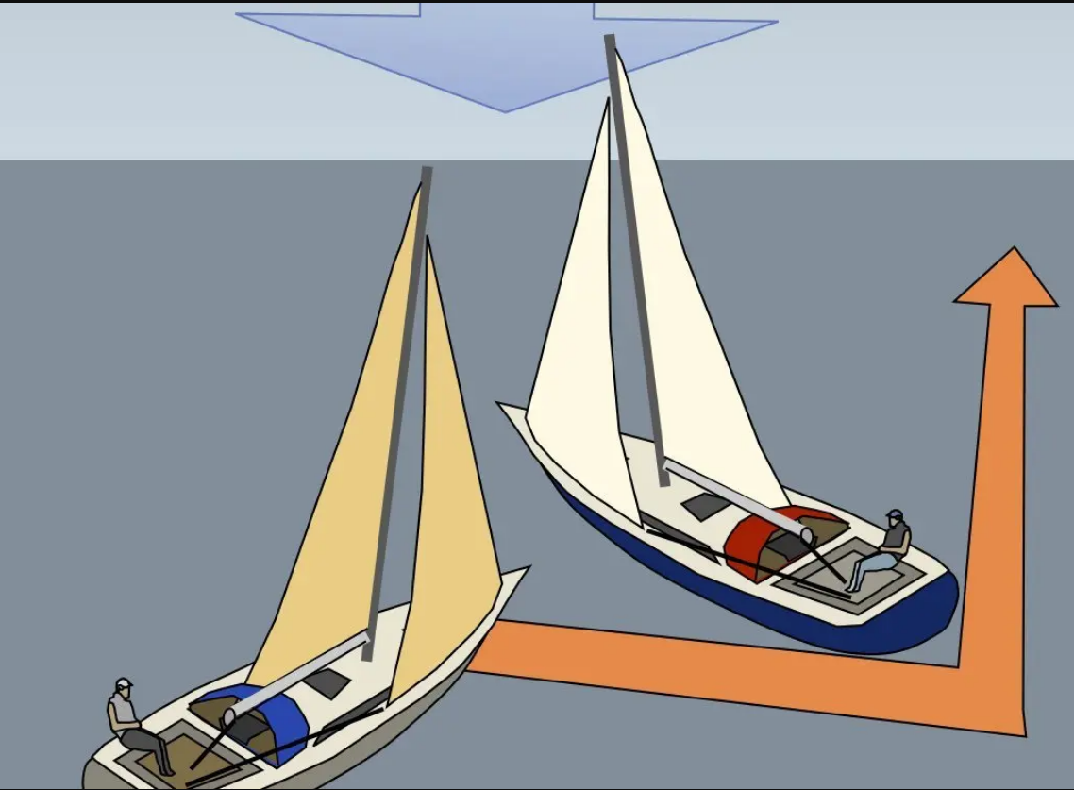
Paupack Sailing Club Right of Way - Wind on Different Sides – Port and Starboard

Slide 11
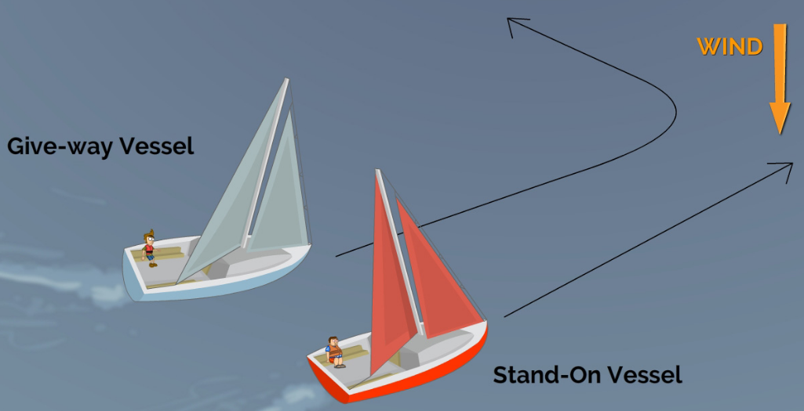
Paupack Sailing Club Right of Way - Wind on Same Side

Slide 12
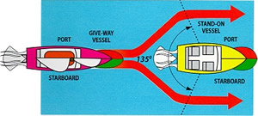
Paupack Sailing Club Right of Way - Overtaking

Slide 13
Paupack Sailing Club Right of Way
Unsure of Other Boats Position - If you have any doubt whether or not a risk of collision exists, you should assume a risk of collision exists and alter your sailboat’s course. It’s always best to default to risk-aversion mode when encountering any similar kind of situation so as to avoid a more dangerous situation to occur.
The Other Boat NOT Staying Clear – Avoid a collision, adjust course and/or speed
Rule 5 Lookout - “Every vessel shall at all times maintain a proper lookout by sight and hearing as well as by all available means appropriate in the prevailing circumstances and conditions so as to make a full appraisal of the situation and of the risk of collision.”
You can designate a lookout helper, and he or she can be a real safety asset, but you’re still responsible.

Slide 14
Paupack Sailing Club PSC Race Committee Preparation
BEFORE THE RACE
It takes three people to run a race: Timekeeper, Flag keeper and Captain. Captain could double as one of the positions. Recruit help prior to race day.
Check the weather the night before and the morning of the race to select a good course based on the forecast wind direction and speed. The race is cancelled if there is active lightning. Best Internet web site for weather is www.weather.com.
A Competition Committee member will meet you at 0900 hrs on Race Day to open the club shed to get the race committee box and supplies.
Ensure that the equipment to run the race is in the race box and working.
Time sheets Pencils
Race instructions Race courses
Signal flags Air horn
Air pump Clock
The Competition Committee member will discuss the possible courses to use for the day and the length of the course based on the current weather conditions.
The Competition Committee member will also explain any race procedure questions you may have or any special instructions for the race.

Slide 15
Paupack Sailing Club PSC Race Committee Preparation
MARKERS
The markers are round red cylinders about 3 feet tall.
Recommend setting the farthest marker first and work your way back to start line.
The markers can be transported deflated and inflated when being set.
The air pump will inflate a mark in about 3 to 5 minutes.
The old marks use two anchors.
Anchors hold the mark in place and go to the bottom of the lake. Shorten anchor line for depth.
The ball weight is used to make the mark stand up straight and has a short 4 to 6 foot line attached to it (Only used on old marks).
Solicit help if needed.
COURSE
The course will be set the day of the race.
Communicate the course to the skippers by displaying the number of the course on the committee boat and by making a call to the fleet over the VHF radio channel 68.
If winds are light, shorten the course, lengthen the course for windier days.
Contact Competition Committee members for advice if needed. (Vice Commodore, Fleet Captains, Statistician).

Slide 16
Paupack Sailing Club Typical Race Course Setup
Windward Leeward Course
Directly into and from the wind
Light air course
Each pass goes through the start finish line
PSC records times on each half lap

Slide 17
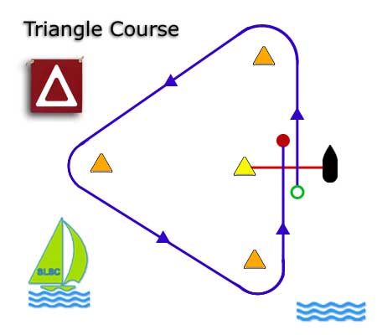
Paupack Sailing Club PSC Race Courses
Triangle Course
Start Straight into Wind
Long Narrow Lake makes Irregular Shapes

Slide 18
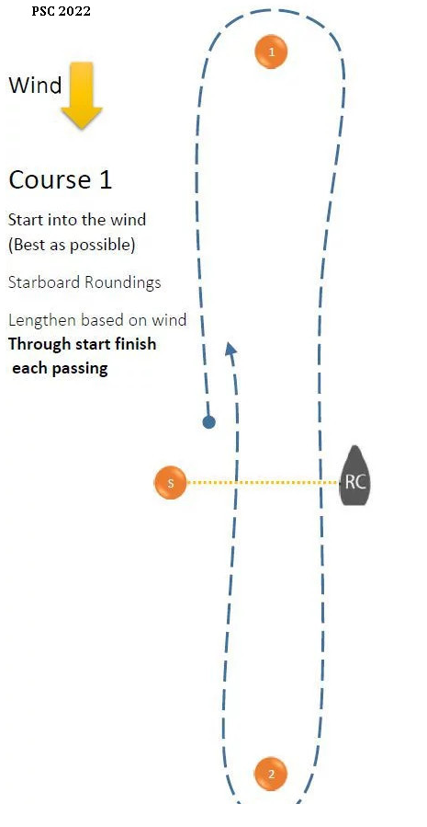
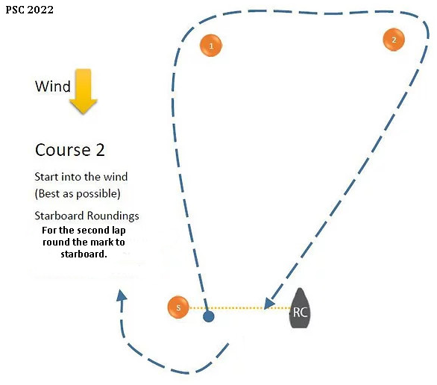
Paupack Sailing Club PSC Race Course 1 and 2

Slide 19
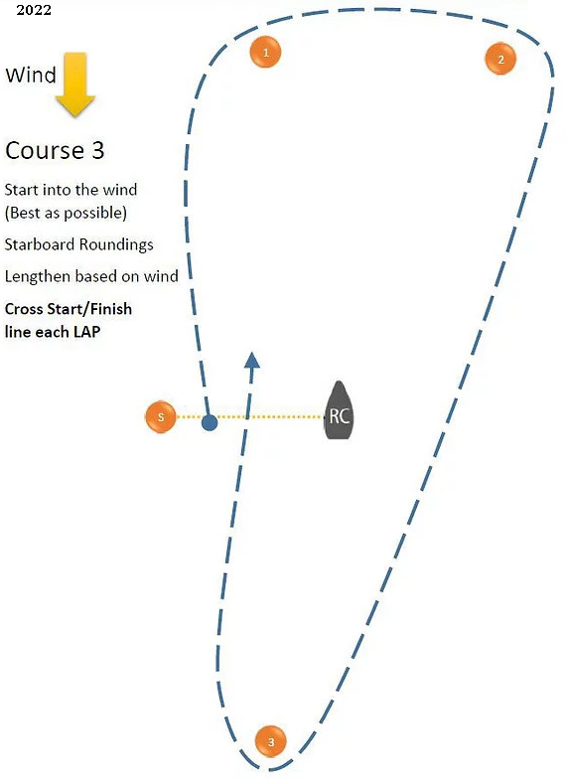
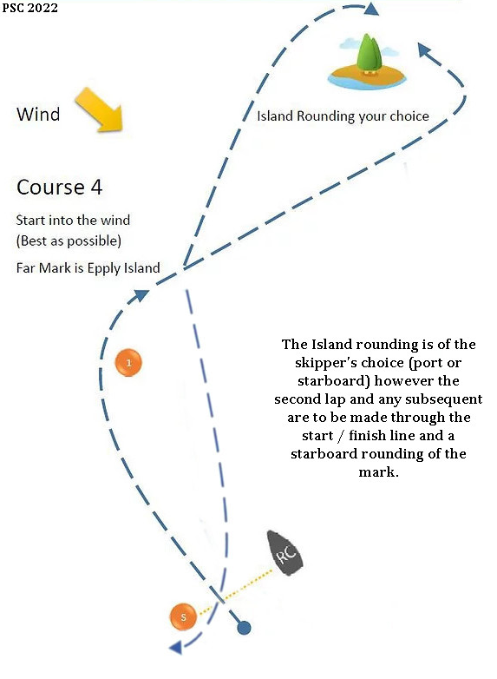
Paupack Sailing Club PSC Race Course 3 and 4

Slide 20
Paupack Sailing Club PSC Race Committee Preparation
START LINE
The start line will be between the pin (Mark used to make the start line) and the Race Committee boat.
Set the start line as perpendicular to the wind and windward mark as possible.
The start line should be at least 2 times the length of the boats in the fleet.
STARTING SEQUENCE
Starting this year, there will two fleets and two starts - 10 minutes apart.
The Cruising Fleet (B-Fleet) race will start at 1200 hrs,
The One Design Racing Fleet (A-Fleet) will start at 1210 hrs,
In the event of no wind at 1200 hrs, the race start can be postponed up to one hour.
If the start is postponed the Race Committee should communicate an expected time that the race start procedure will be resumed.
RECORD RESULTS
Record the start time for each Fleet
Record the clock time of each boat after each lap completed on the scoring sheet.

Slide 21
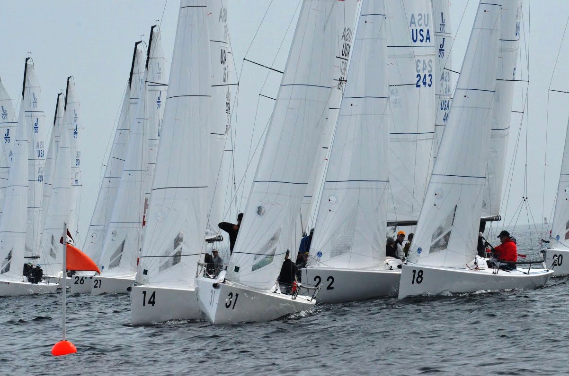
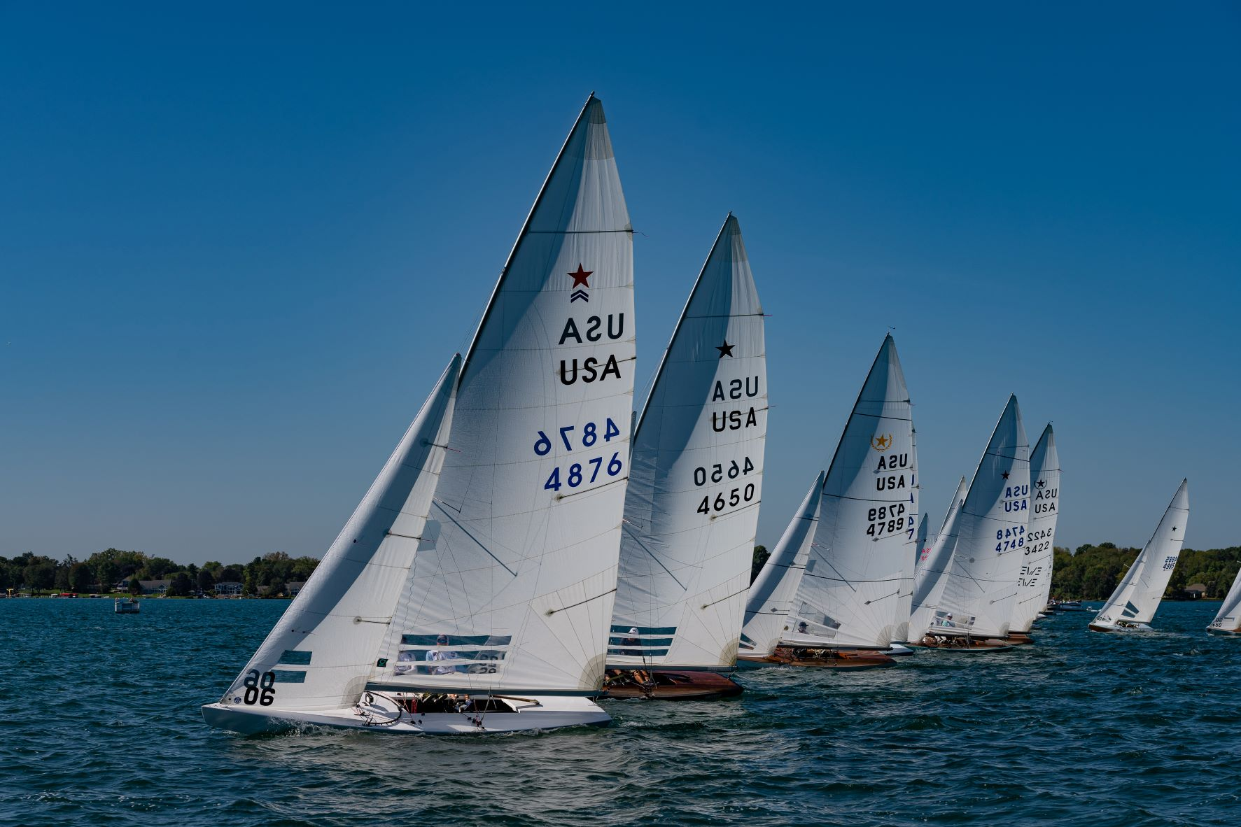
Paupack Sailing Club Start of Race
Registering with Race Committee
Radios – VHF Channel 68
No Communication with Race Committee after 10 minute countdown starts
Stay Clear of start line and boats if you are not starting

Slide 22
Paupack Sailing Club Start of Race - RACE COUNTDOWN TIME SEQUENCE
B - Fleet Start Sequence
Time | Event
11:49 | 1 Long Blast
11:50 | White Flag Up - 1 Short Blast
11:54 | White Flag Down
11:55 | Blue Flag Up - 1 Short Blast
11:59 | Blue Flag Down
12:00 | Red Flag Up - Sound Horn – Start of B Fleet Race
A - Fleet Start Sequence
Time | Event
12:00 | Record Wind Speed for Start of Race
12:00 | Red Flag Up – Start of 10 Minute Countdown
12:04 | Red Flag Down
12:05 | Blue Flag Up - 1 Short Blast
12:09 | Blue Flag Down
12:10 | Red Flag Up - Sound Horn – Start of A Fleet Race

Slide 23
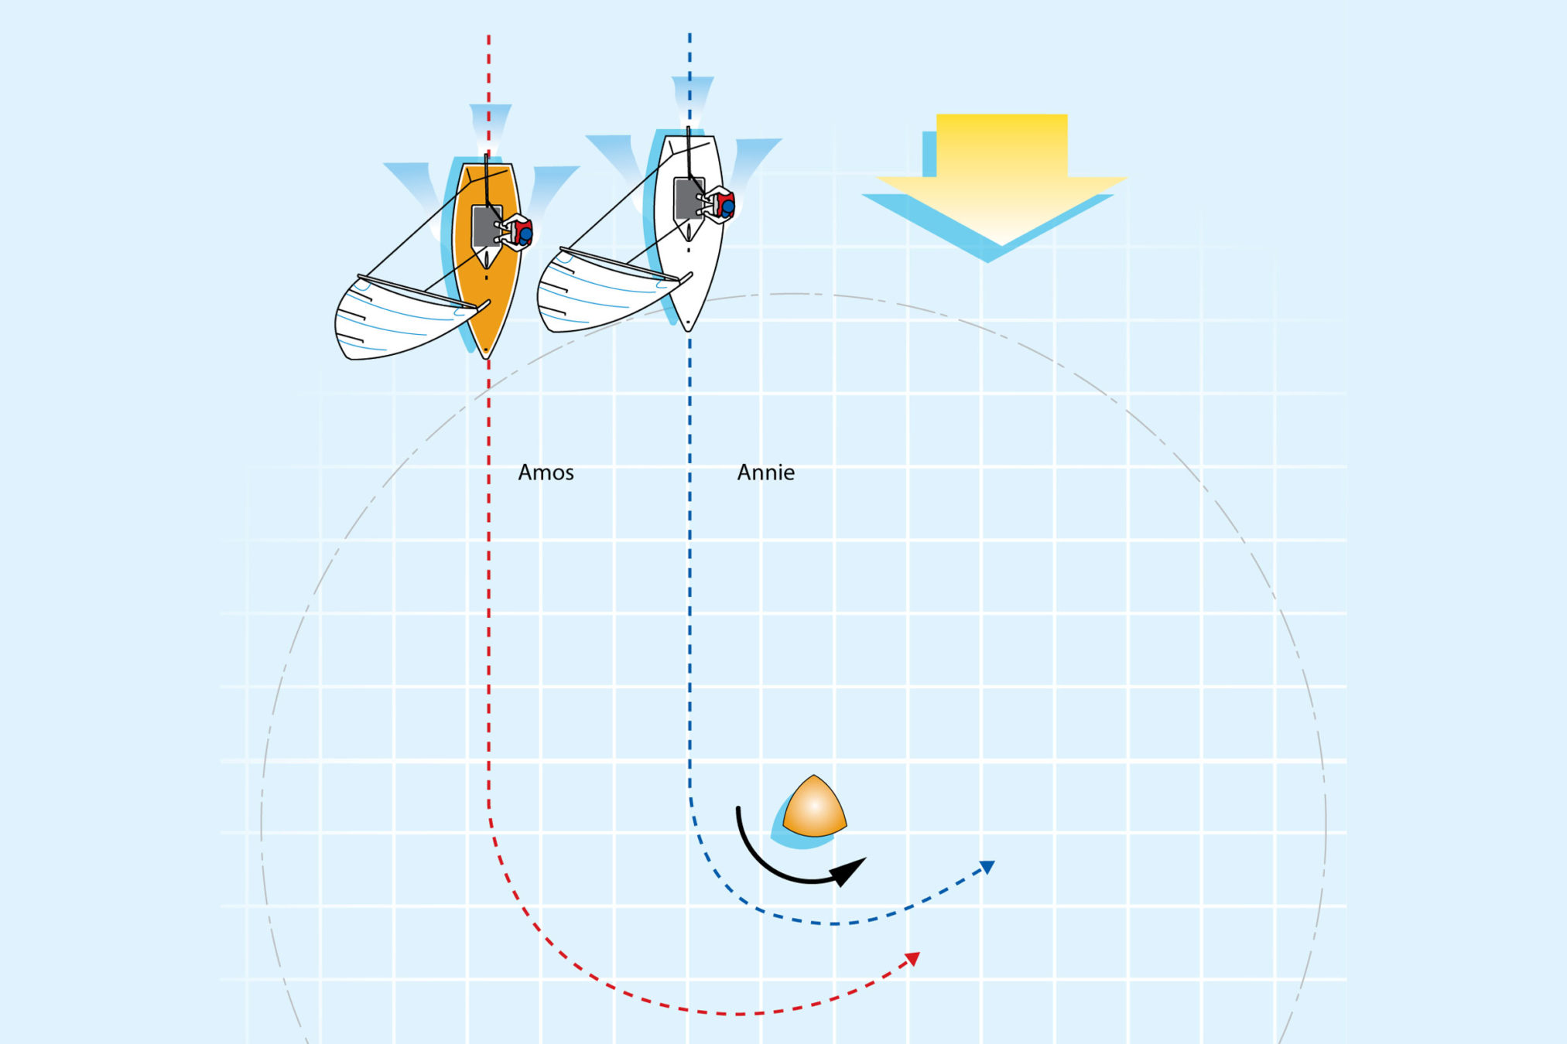
Paupack Sailing Club Pins and Marks
Starting Pin does not require room to maneuver
Provide Room at a Mark
Overlap within3 Boat lengths

Slide 24
Paupack Sailing Club PSC Race Rules
PSC Time Limits
Start of Race Requires 4 knots of Wind
Not enough Wind to Start the Race by 1:00
No Boat Reaches the First Mark in 45 Minutes
Immediate Termination of a Race
Visible Lightning
2/3 rds of the Club that started must finish a lap for the lap to count
A lap must be completed by 4:00 for the lap to be scored
If you miss a race, scored by the number of boats + 1
The highest 2 scores of the season are thrown out

Slide 25
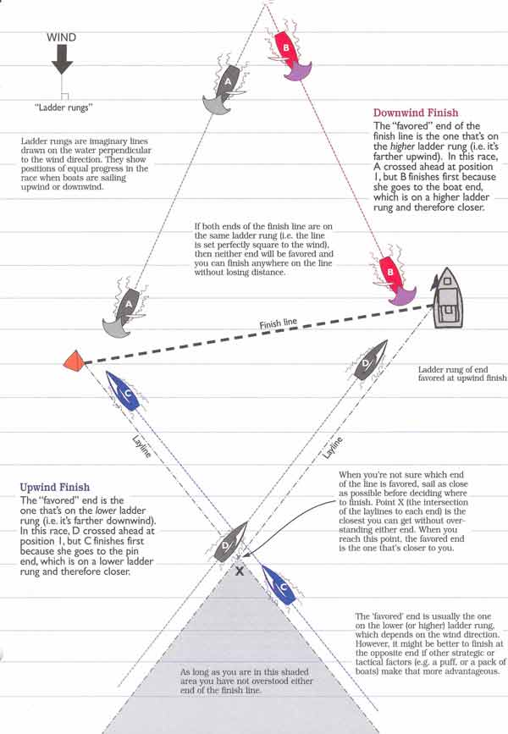
Paupack Sailing Club Race Tactics
Sail Shorter
Ladders and Wind Shifts

Slide 26
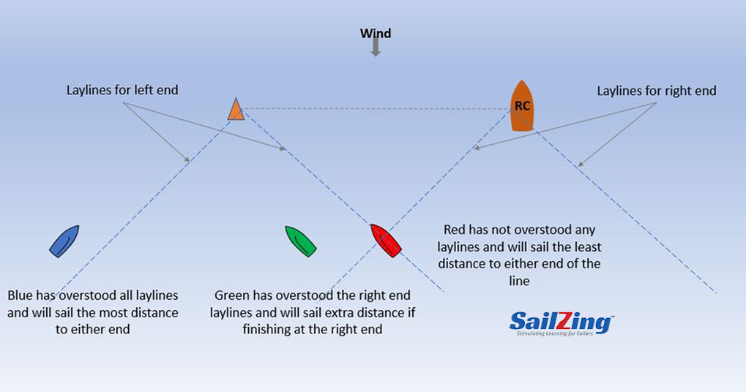
Paupack Sailing Club Race Tactics
Sail Shorter
Lay Lines and Wind Shifts

Slide 27
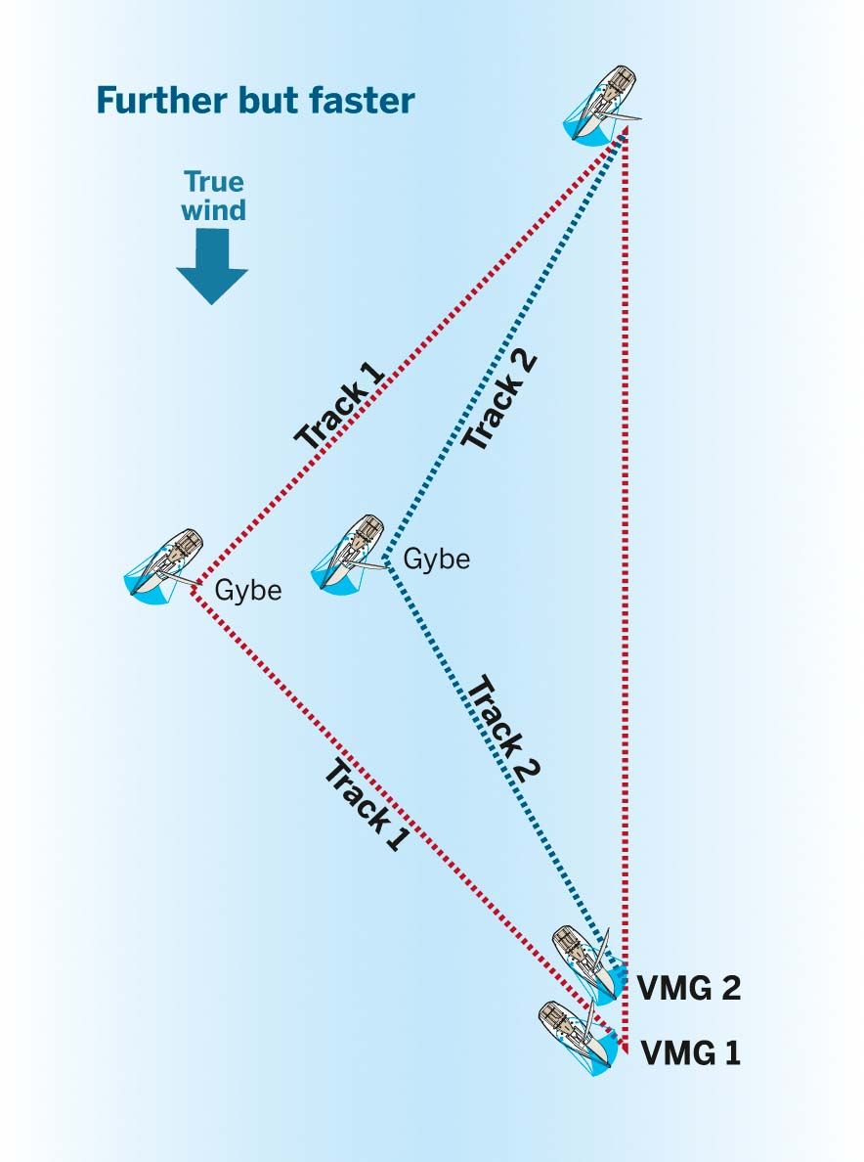
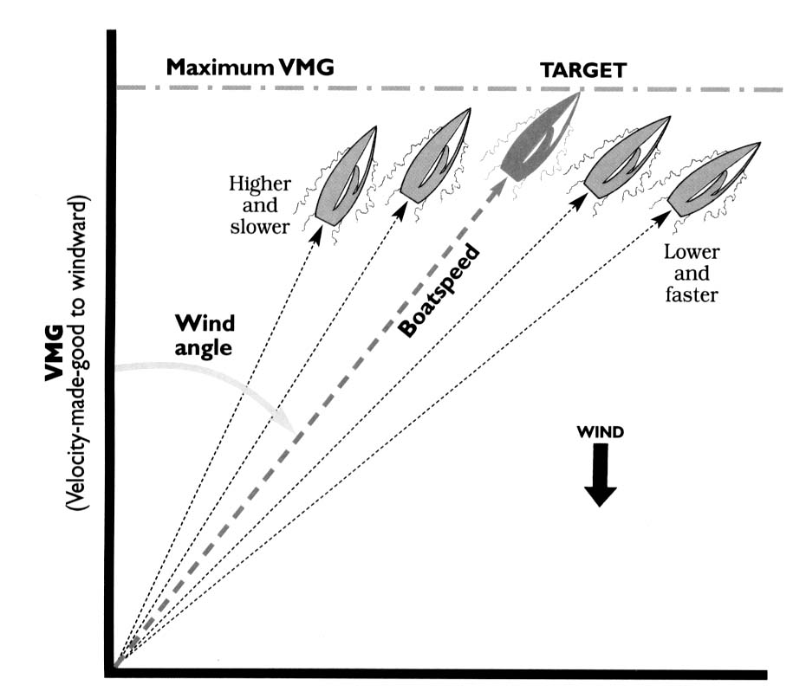
Paupack Sailing Club Race Tactics
Velocity Made Good
Sail Shorter ?
Sail Faster ?

Slide 28
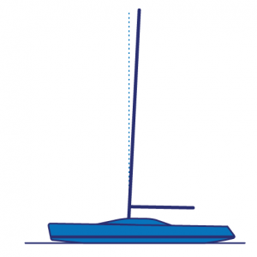
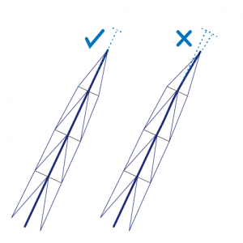
Paupack Sailing Club Race Tactics
Mast Tuning
Find a guide for your boat
Rake – Changes Center of Balance/Weather Helm
Center your Mast – Upper Shrouds First, Halyard to Both Sides
Mast in Column – Use lower shrouds and Halyard to align mast
Bend – Tighten Uppers to Bend Mast
Tip Fall Off and Side Bend

Slide 29
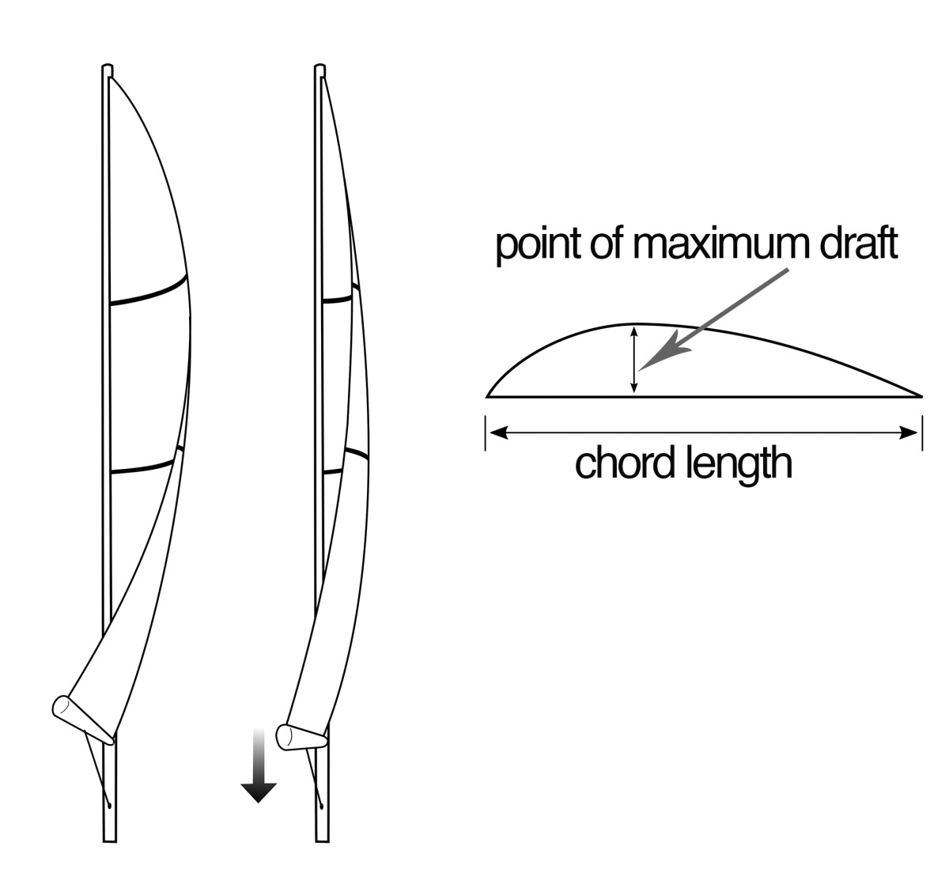
Paupack Sailing Club Race Tactics
Sail Faster – Main Sail Trim
Deeper Draft in Light Air
Top Batten Parallel to Boom / No Twist
Bigger Air, More Heel
Flatten Sails as Heel Increases
Tighten Halyard, Cunningham, Outhaul to Move Draft Forward
Loosen Main Sheet to increase twist, Spill Air
Watch Telltales for Proper Trim
Flow Straight Back
Top Leach Telltale May Wrap Leeward
To Much Weather Helm (Rudder Drag)
Flatten Main, Ease Main, Still to Much?
Move Mast Rake Forward

Slide 30
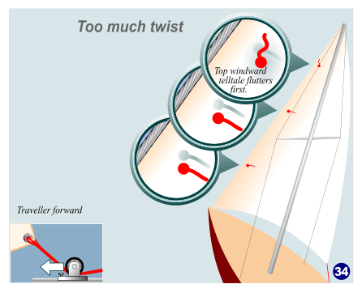
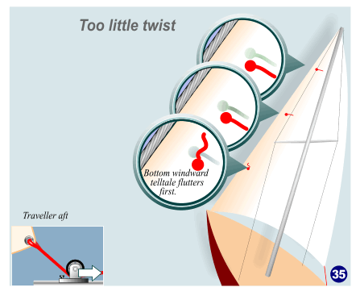
Paupack Sailing Club Race Tactics
Sail Faster – Genoa/Jib Sail Trim
Tighten Halyard, Forestay or Backstay to Flatten Head Sail in Bigger Wind

Slide 31
Paupack Sailing Club Race Tactics
Sail Faster – Balance Your Sails
Keep Slot Open
To Much Weather Helm (Rudder Drag)
Flatten Main, Ease Main
Still to Much?
Move Mast Rake Forward

Slide 32
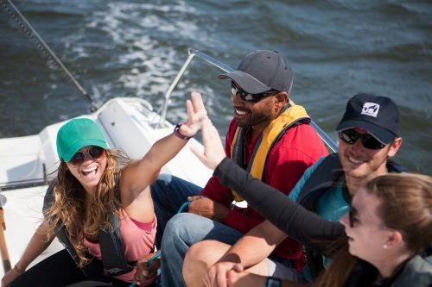
Paupack Sailing Club Is a Fun Club
No Off the Water Protests
Learn by Doing
Improve Your Sailing Skills
Meet Great People!

