Slide 1
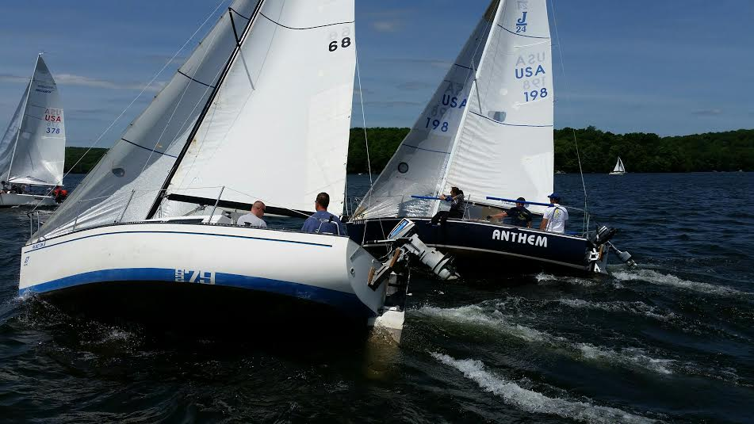
Introduction to Sailing Paupack Sailing Club

Slide 2
Safety First – Neat, Clean, Prepared Paupack Sailing Club
Required Safety Gear on the Boat
Life Vests
Throwable Flotation Device
Fire Extinguisher
Visual Signaling Devices
Sound Signaling Devices
Recommended Safety Equipment
Medical Kit
Anchor and line
Bailing Device
Oars or Paddles
Cell Phone / VHF Radio
Mask/Snorkel to inspect under Boat
Knife to cut a fouled line
Flashlight
Method of getting weather updates
Additional Items
Food and Water
Suntan Lotion

Slide 3
Safety First - Knots Paupack Sailing Club

Slide 4
Safety First - Knots Paupack Sailing Club

Slide 5
Safety First - Knots Paupack Sailing Club

Slide 6
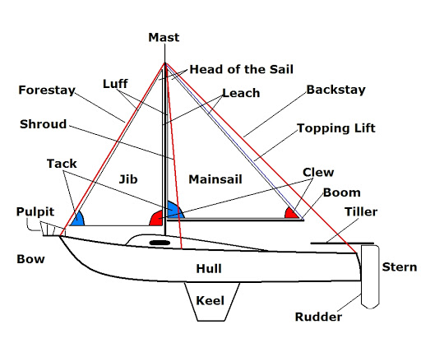
Safety First - Terminology Paupack Sailing Club

Slide 7
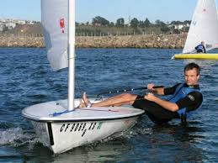
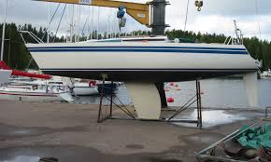
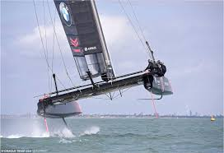
Safety First – Types of Sailboats Paupack Sailing Club
Dingy
Keelboat
Hydrofoil

Slide 8
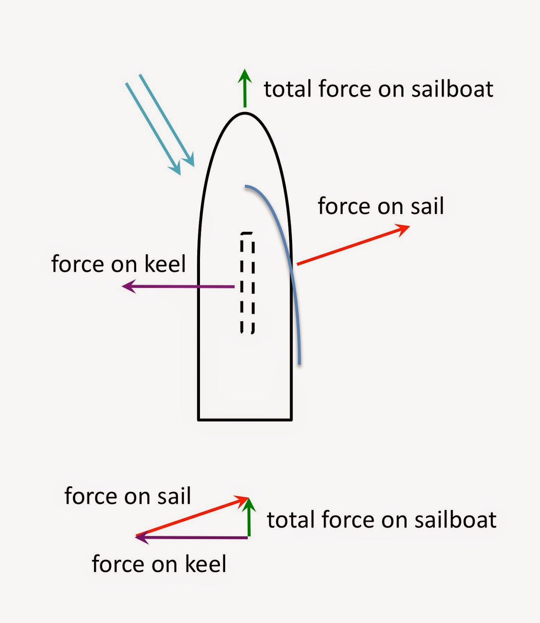
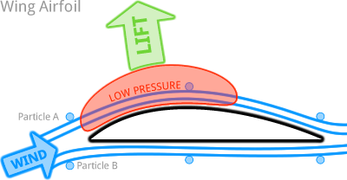
Sailing – How Does A Sailboat Move Paupack Sailing Club

Slide 9
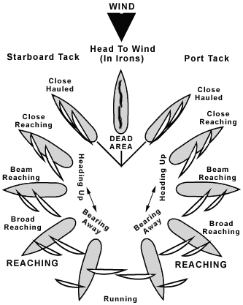
Sailing – How Does A Sailboat Move Paupack Sailing Club
Angle of attack or sail to the wind
At different headings
https://vimeo.com/163707960

Slide 10
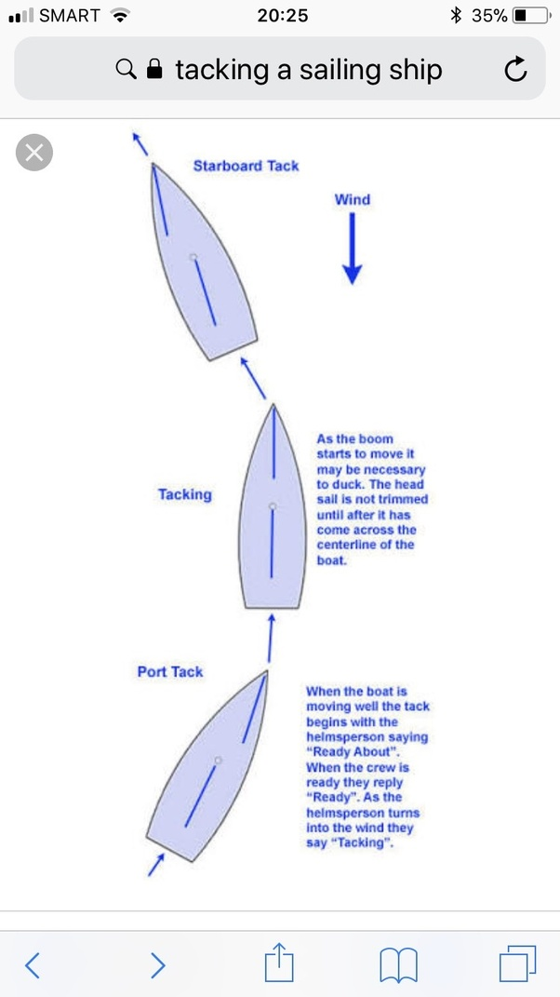
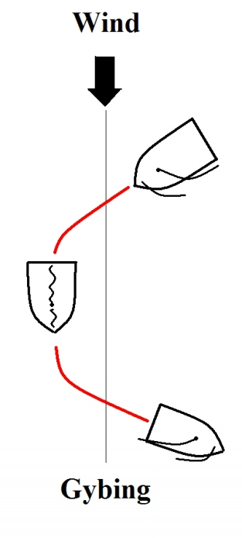
Sailing – How Does A Sailboat Move Paupack Sailing Club

Slide 11
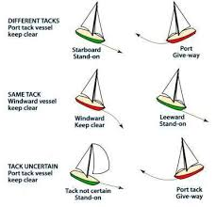
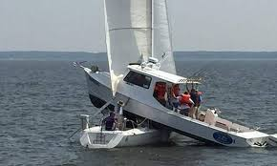
Sailing – Right of Way Paupack Sailing Club

Slide 12
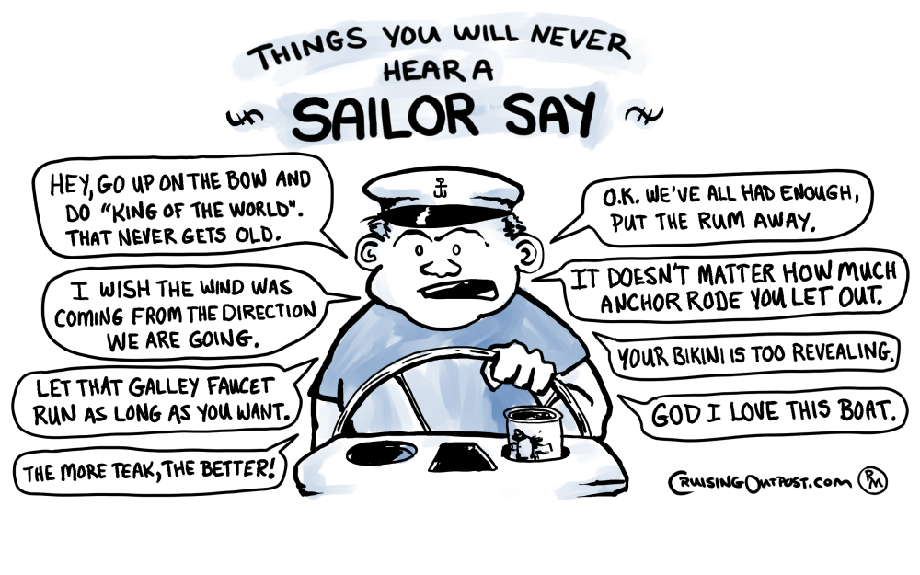
Sailing – Is really FUN Paupack Sailing Club
Can be nice and Relaxing
Fun and Sun
Build relationships that last a lifetime
Learn new skills, electrical, fiberglass, engine repair, etc.
Satisfaction of being self sufficient and able to handle any situation

Slide 13
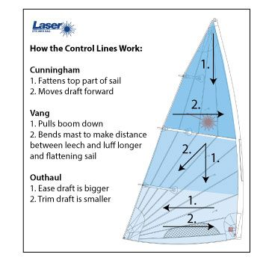
Sailing – Is really FUN Paupack Sailing Club
Technical and demanding to go Fast
Mast Rake and Bend
Sail Shape Forestay
Jib Cars
Cunningham
Outhaul
Traveler
Mainsheet
Backstay
VMG
Strategy and Tactics

Slide 14
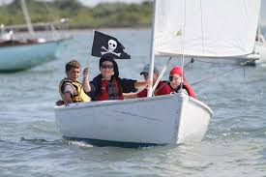
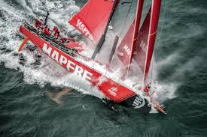
Sailing – Is really FUN Paupack Sailing Club
Sailing takes Minutes to Understand and a Lifetime to Master

